Slide 1

RNA-sequencing: from reads to biological insight
Dr. Lukas Simon
Helmholtz Zentrum München
Institute of Computational Biology
Computational Modelling Week Oslo 2017

Slide 2
Outline
Introduction to next generation sequencing
DNA-seq
RNA-seq
Workflow
Quality control
Normalization
Statistical modeling
Alternative splicing
Allele-specific expression
Single-cell RNA-seq

Slide 3
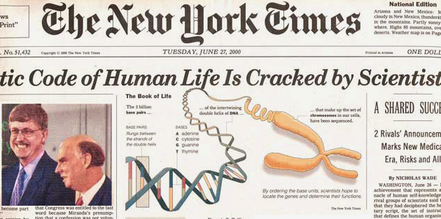
First draft of human genome was sequenced in 2000

Slide 4
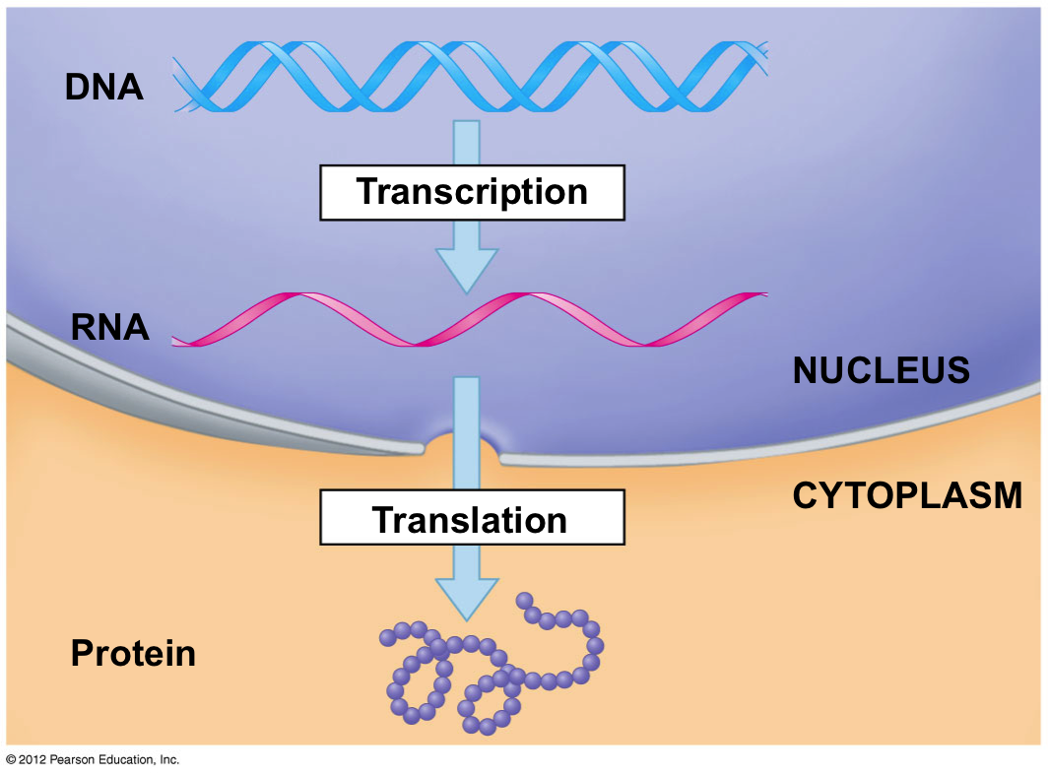
The central dogma of molecular biology

Slide 5
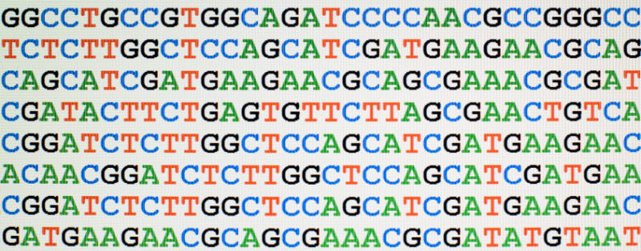
What is sequencing?
DNA/RNA sequencing is the process of determining the precise order of nucleotides within a DNA/RNA molecule

Slide 6
The central dogma of molecular biology

Slide 7

Notes:
The answer is hidden in this image.

Slide 8
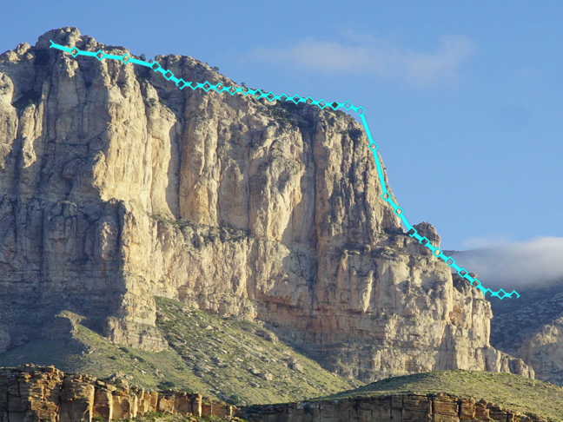

Slide 9
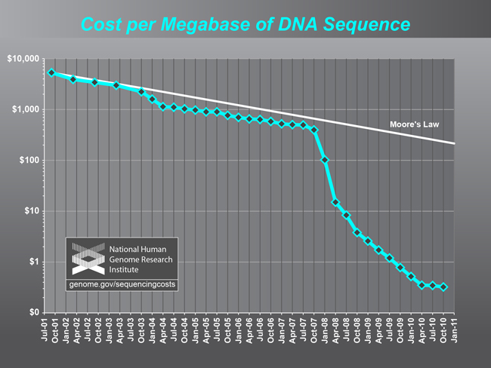
Next generation sequencing
Notes:
This curve is a symbol of the recent development of technologies which allow us to assay biology in an unprecedented level of detail and comprehensiveness. This is the symbol of the era of “omics”

Slide 10
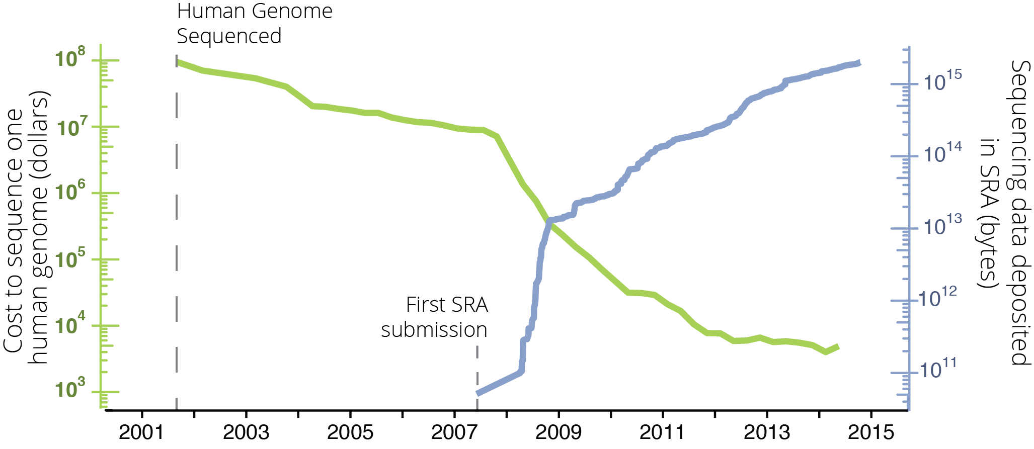
There exists A LOT of RNA-seq data

Slide 11
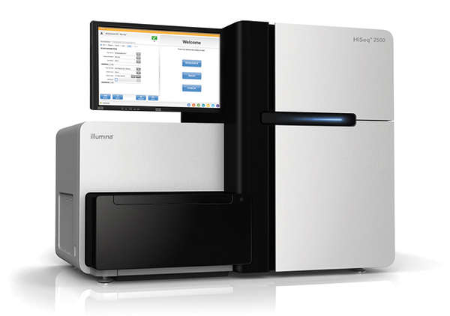
Next generation sequencing
Key: Massively parallel sequencing

Slide 12

Illumina sequencing workflow

Slide 13
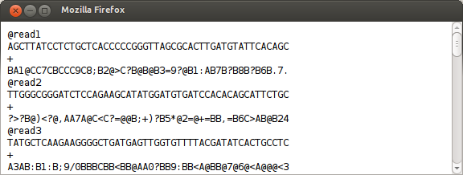
Raw file format (FASTQ)

Slide 14
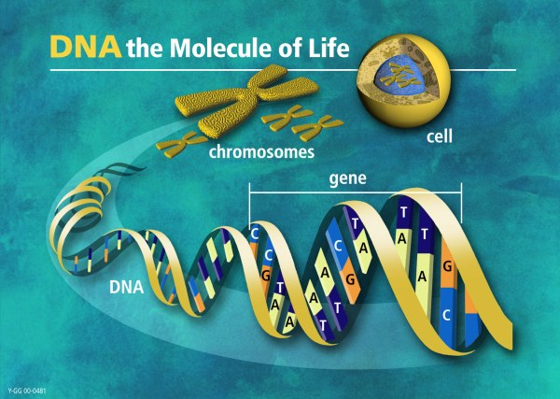
DNA-seq

Slide 15
DNA-seq

Slide 16
Alignment of fragments
Large DNA molecule
Fragmentation
Alignment
Reference genome

Slide 17
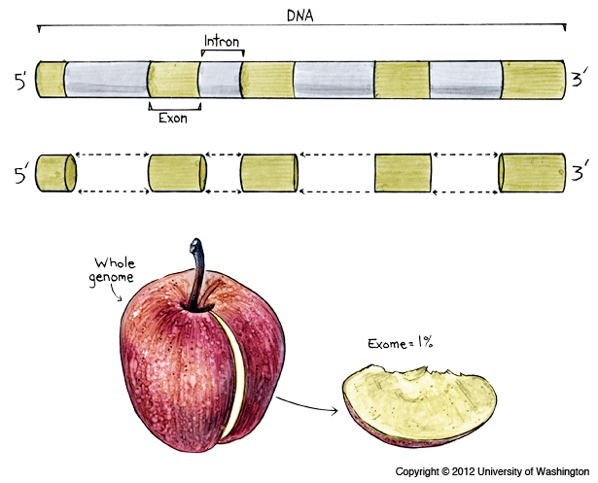
DNA-seq: Whole genome vs exome sequencing
Thought experiment:
Length (wg)=3e9 bases
Length (f)=100
How many reads should I sequence?

Slide 18
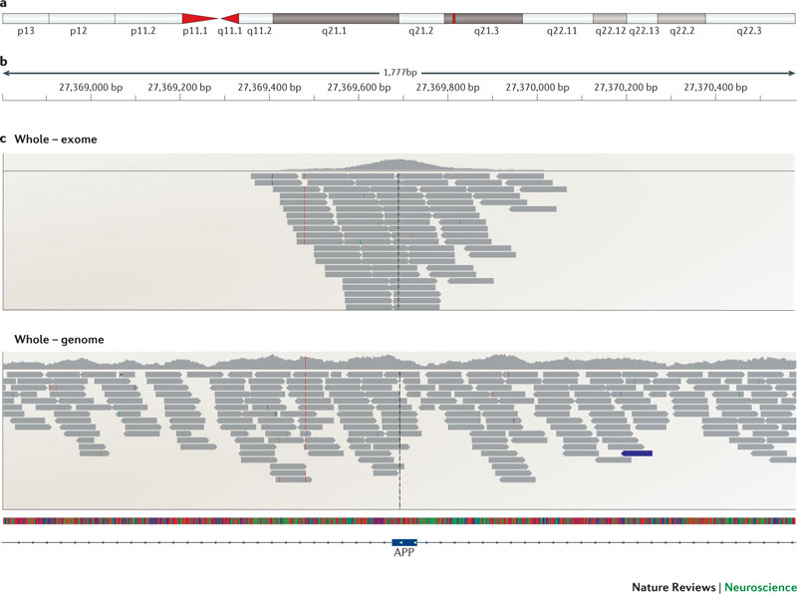
DNA-seq: Whole genome vs exome sequencing

Slide 19
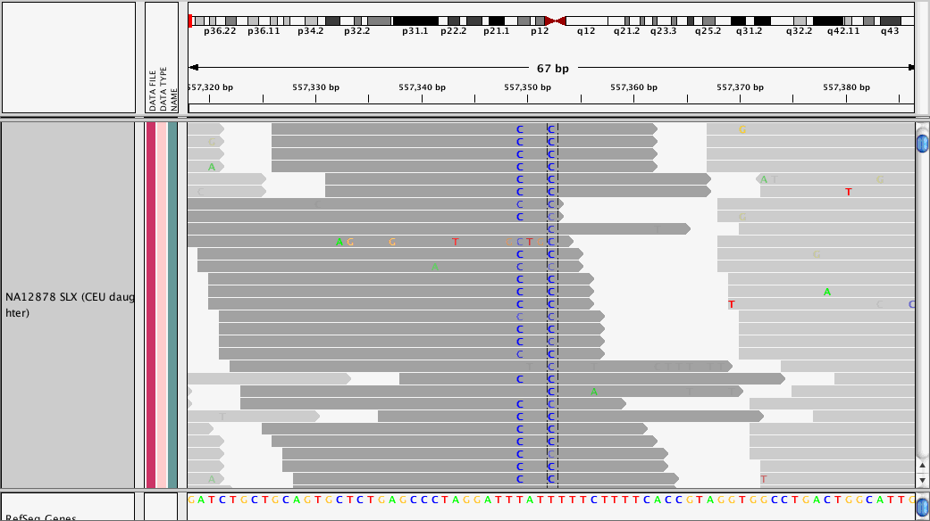
Identification of genetic variation (SNPs)

Slide 20
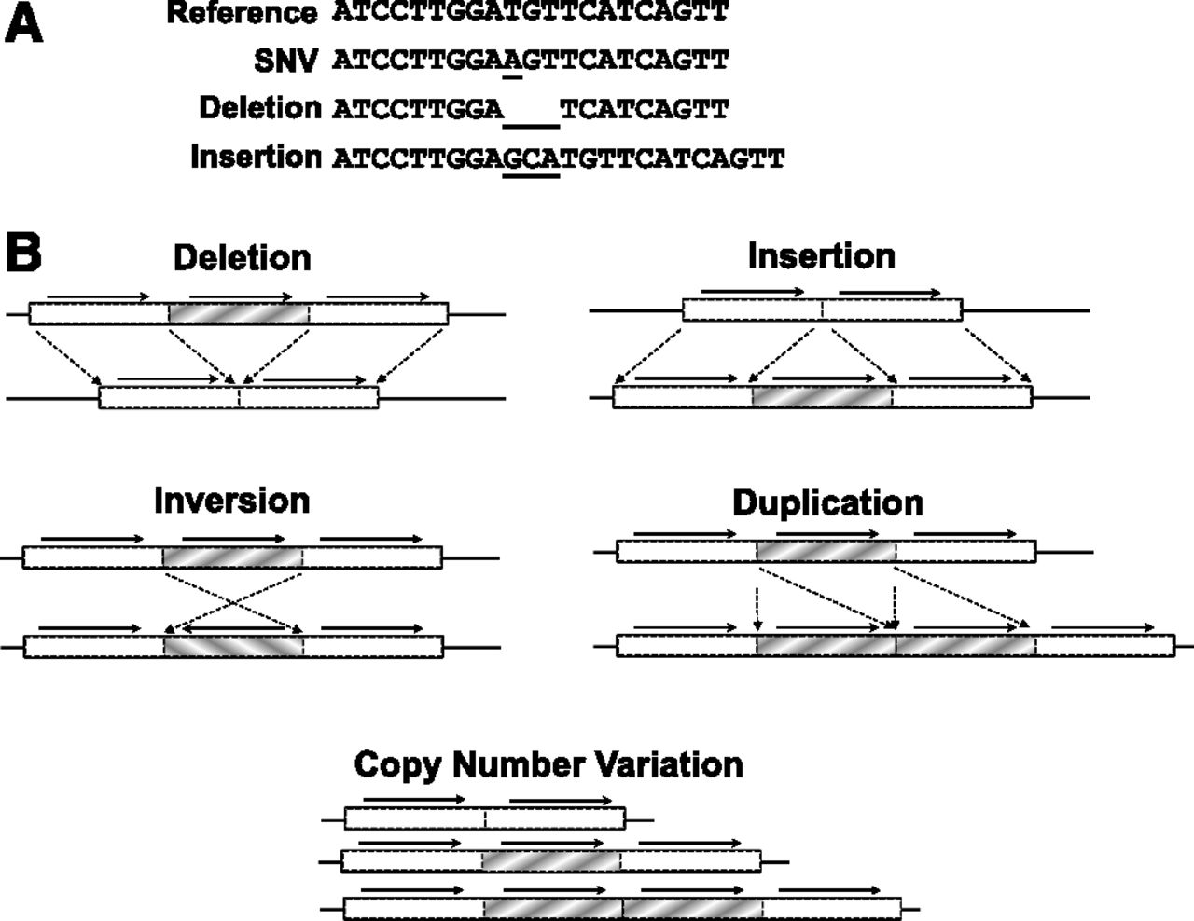
Identification of structural variation

Slide 21
RNA-seq

Slide 22
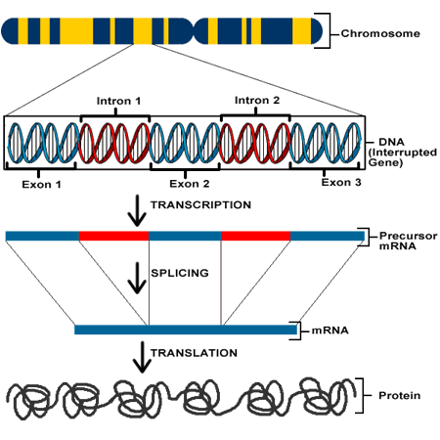
RNA-sequencing

Slide 23
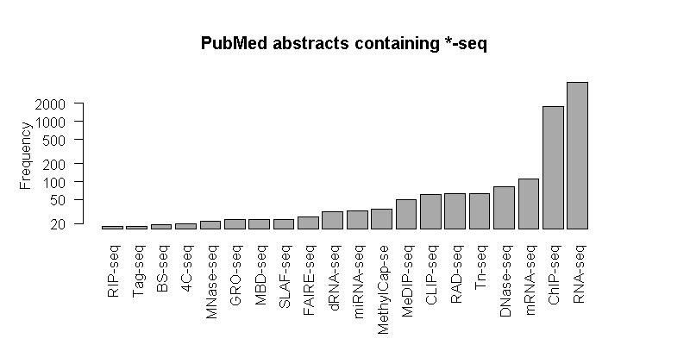
RNA-seq is the most popular *-seq
Notes:
11k pubmed abstracts

Slide 24
RNA-seq workflow
mRNA
5’
AAAA 3’
Fragmentation
Alignment
Reference gene
Notes:
Perform alignment tutorial

Slide 25


Size of an RNA-seq experiment
50M reads
100bp each
Paired end
3000 bibles
=1e10 characters
5 case
5 control
30000 bibles
=1e11

Slide 26
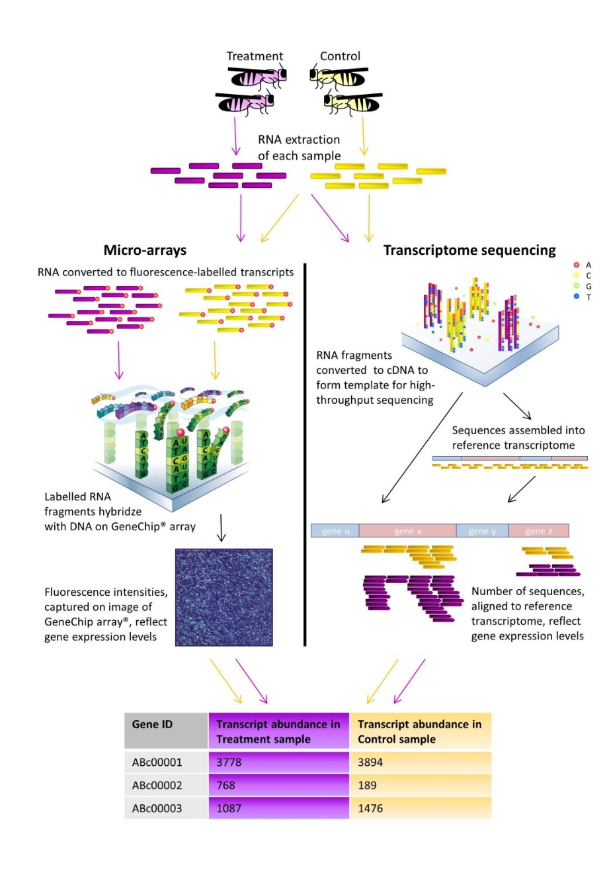
RNA-seq versus microarrays
ACTGATATGTAG
ACTGATATGTAG
Adapted from Wertheim, 2012
Notes:
RNAs labelled
Hybridized to predfined set of oligos
Gene expression estimate inferred from fluorescence intensity

Slide 27
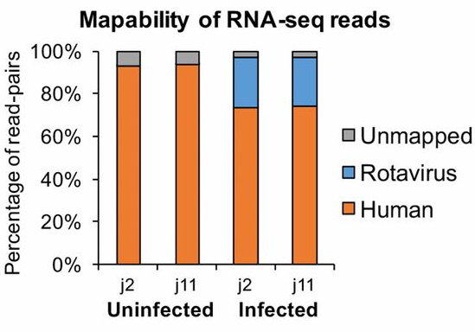
Unbiased detection of RNA molecules
Saxena K, Simon LM et al. PNAS 2017

Slide 28
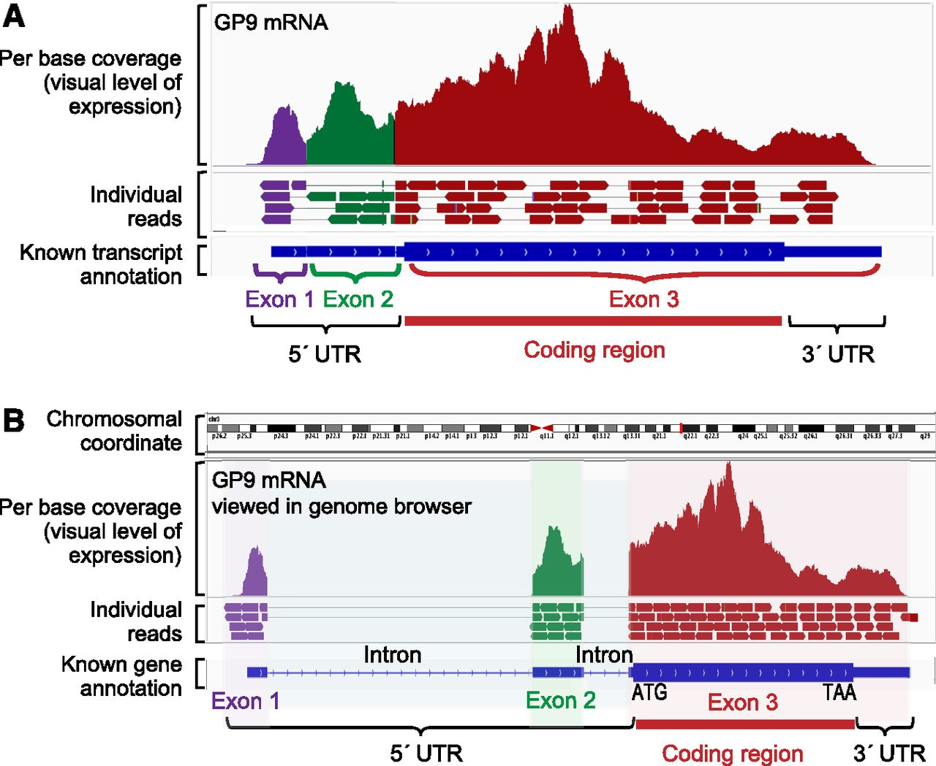
Genome-based view of RNA-seq alignment
Schubert et al. Blood 2014

Slide 29
Transcript-based view of RNA-seq alignment
Expression
level
Schubert et al. Blood 2014

Slide 30
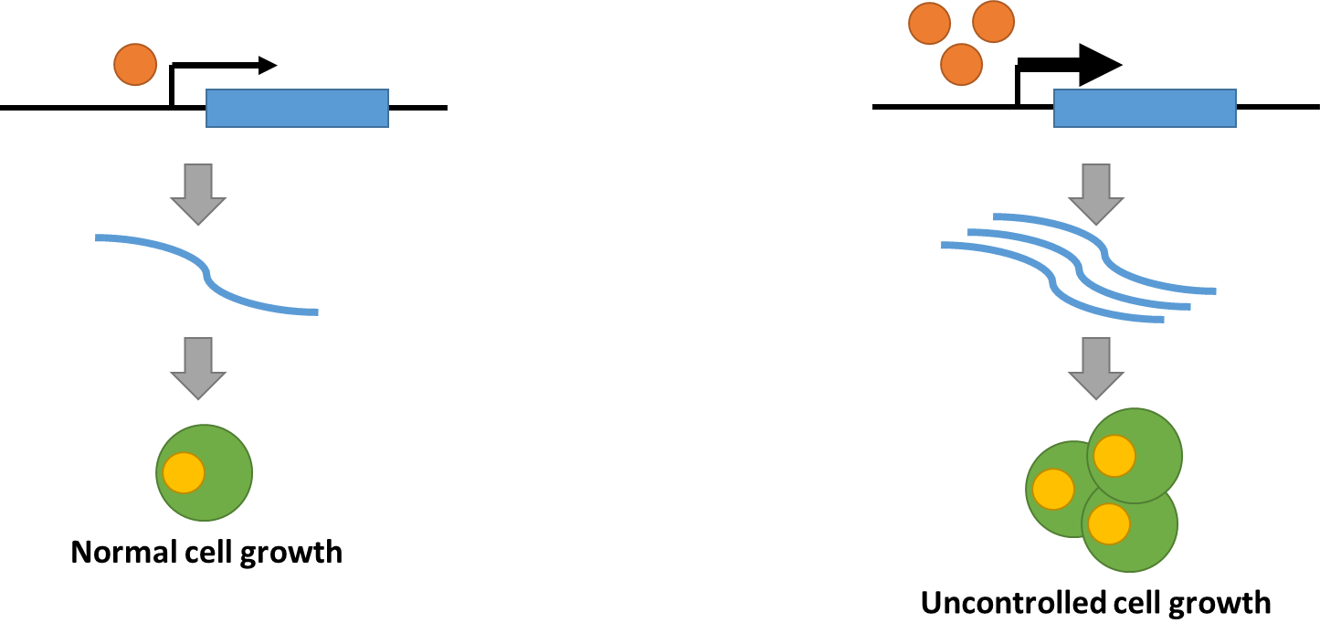
Example: MYC expression in cancer
MYC is a transcription factor and prominent oncogene.
High expression levels of MYC drive tumorigenesis.
Can you recognize which sample comes from the tumor? Which from the normal?

Slide 31
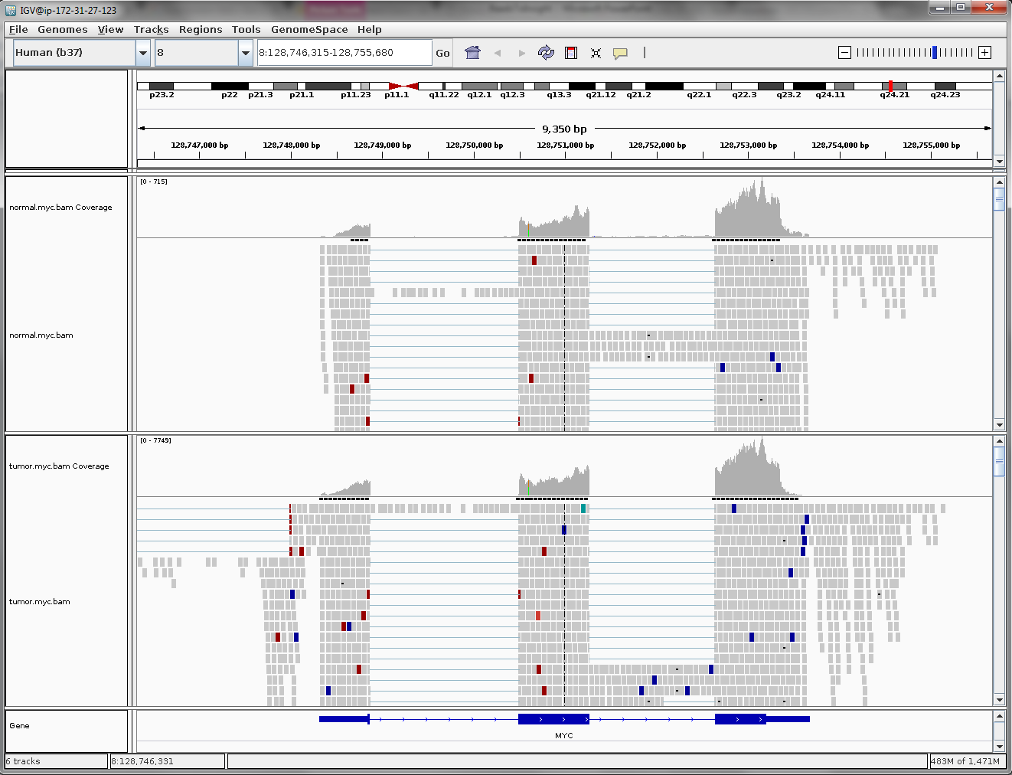

Slide 32
Quality control of NGS data

Slide 33
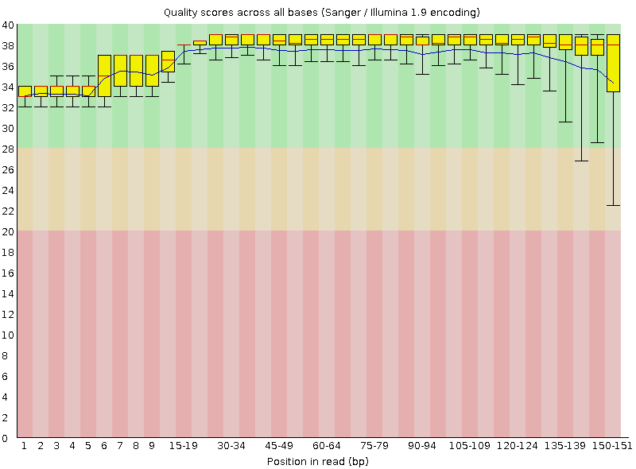
Quality control of NGS data

Slide 34
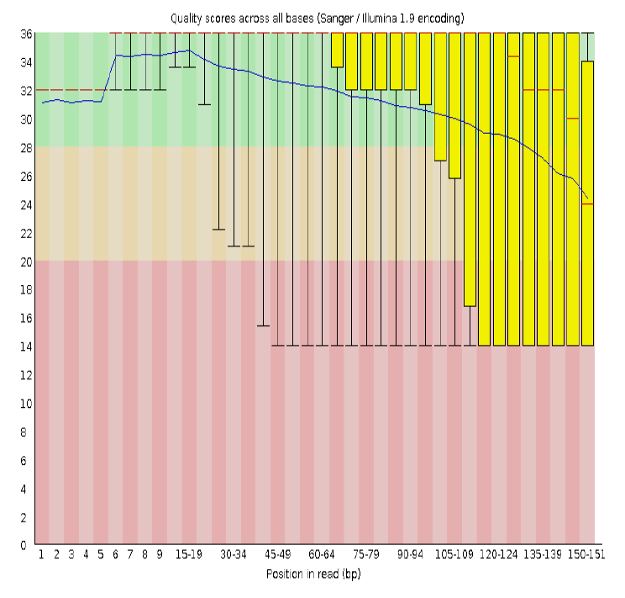
Quality control of NGS data

Slide 35
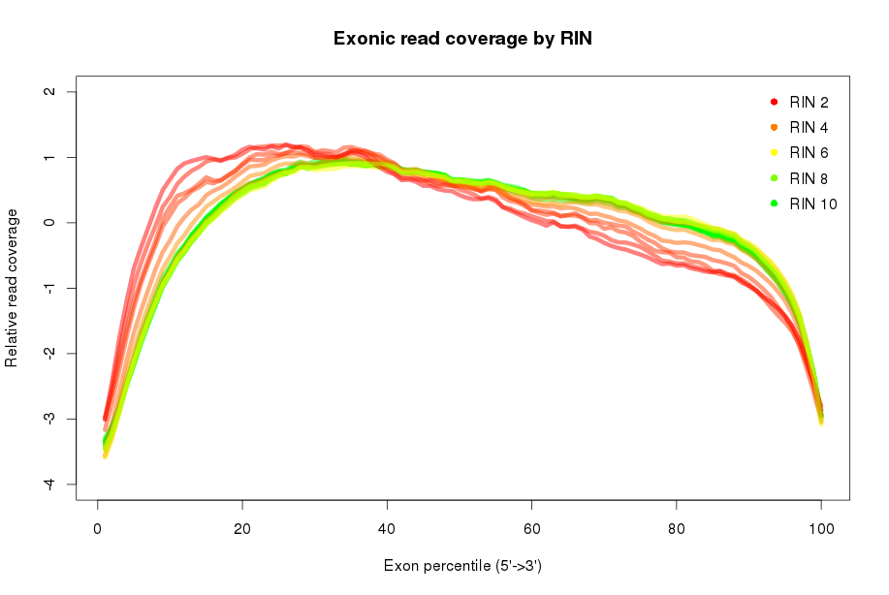
Quality control of NGS data

Slide 36
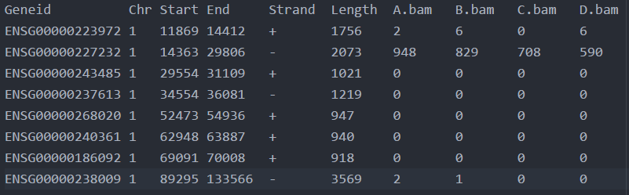
RNA-seq ‘counts’ the gene expression

Slide 37
Normalization of RNA-seq data
What do we need to normalize for?
Library size/ total reads sequenced
Gene length
GC content

Slide 38
Normalization of RNA-seq data
RPKM or FPKM
Reads/Fragments
/ Kilobase
/ Million reads sequenced
 | sample1 | sample2 | sample3 | …
gene1
gene2
gene3
gene4
gene5
gene6
…

Slide 39
Normalization of RNA-seq data
DESeq2 normalization
 | sample1 | sample2 | sample3 | …
gene1
gene2
gene3
gene4
gene5
gene6
…

Slide 40
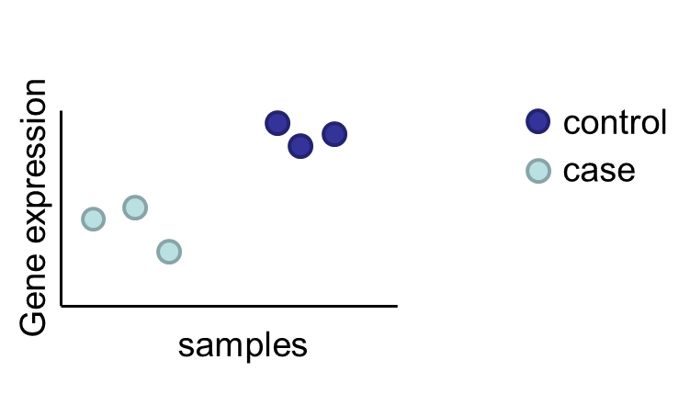
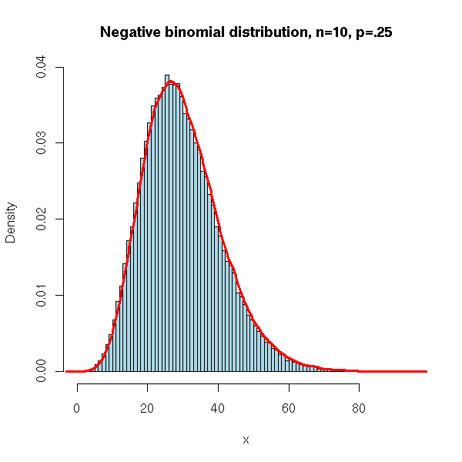
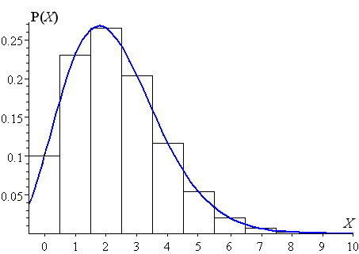
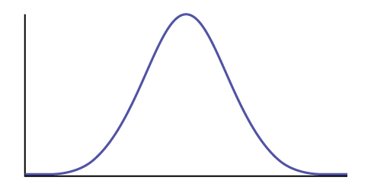
Statistical modeling of differential gene expression

Slide 42
Differential gene expression
case
control
 | sample1 | sample2 | sample3 | sample4
gene1
gene2
gene3
gene4
gene5
gene6
…

Slide 43
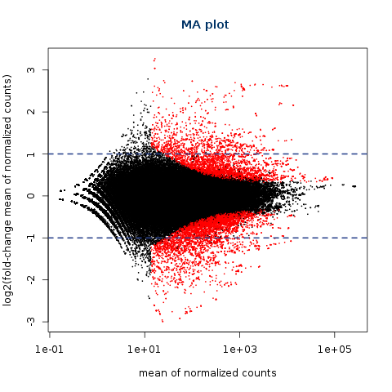
Statistical uncertainty is higher in low counts

Slide 44
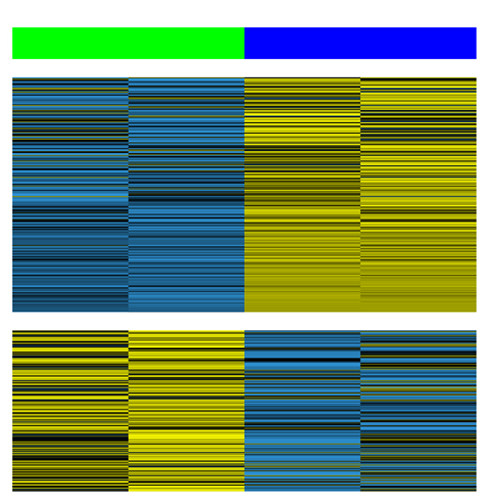
Differential gene expression
healthy
infected
Up-regulated genes
Down-regulated genes
Saxena K, Simon LM et al. PNAS 2017

Slide 45
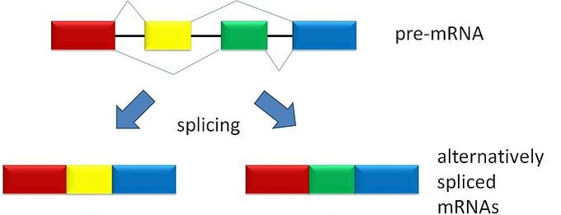
Alternative splicing

Slide 46
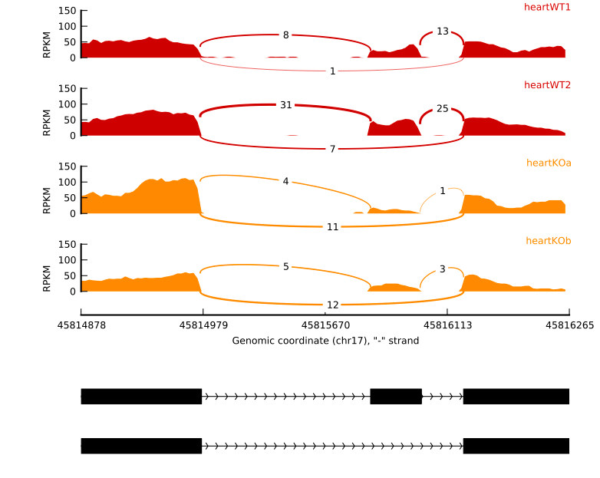
RNA-seq data contains information on alternative splicing

Slide 47
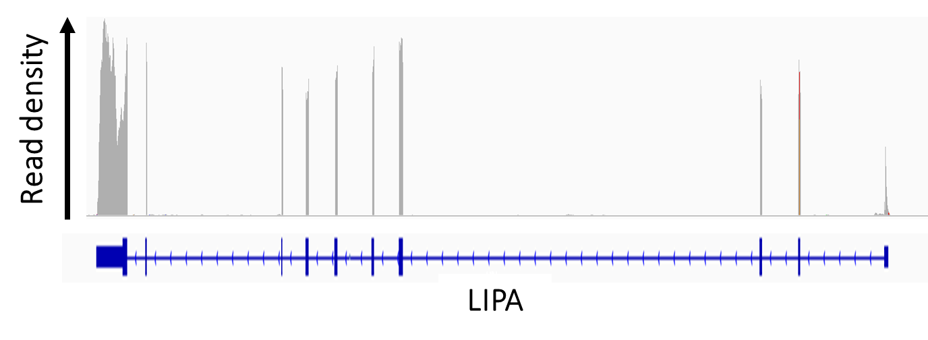
RNA-seq data contains allele-specific information

Slide 48
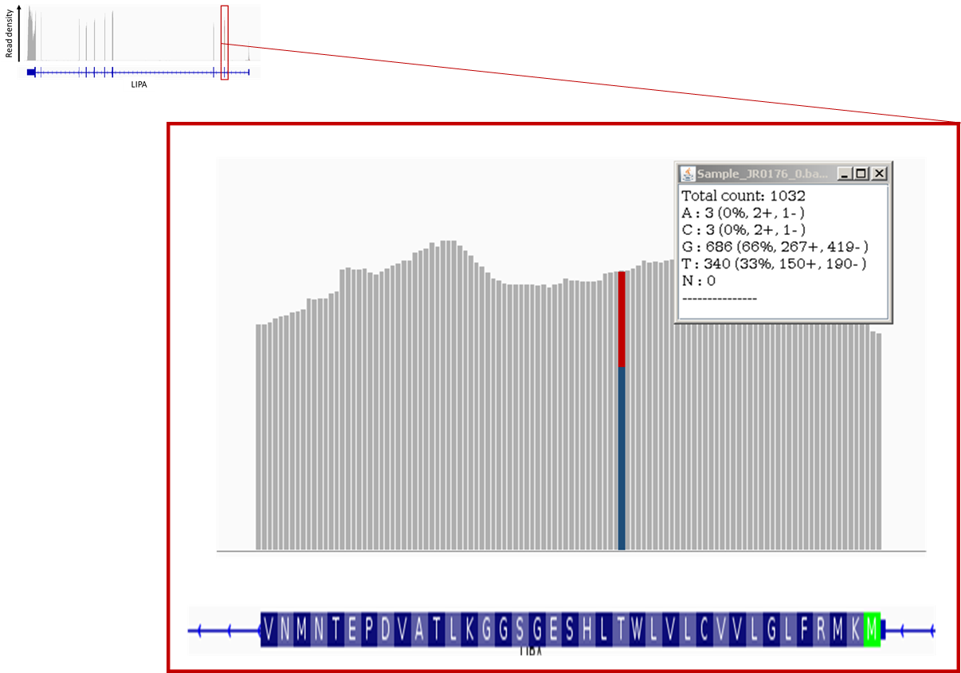
RNA-seq read pileups provide allele specific expression information

Slide 49
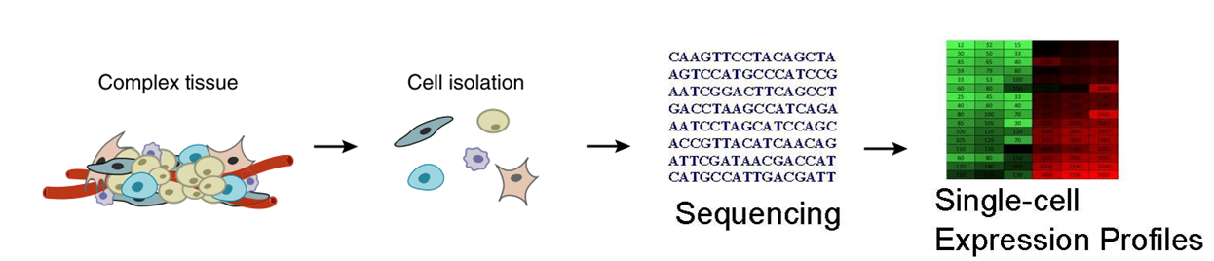
Single cell RNA-seq workflow

Slide 50
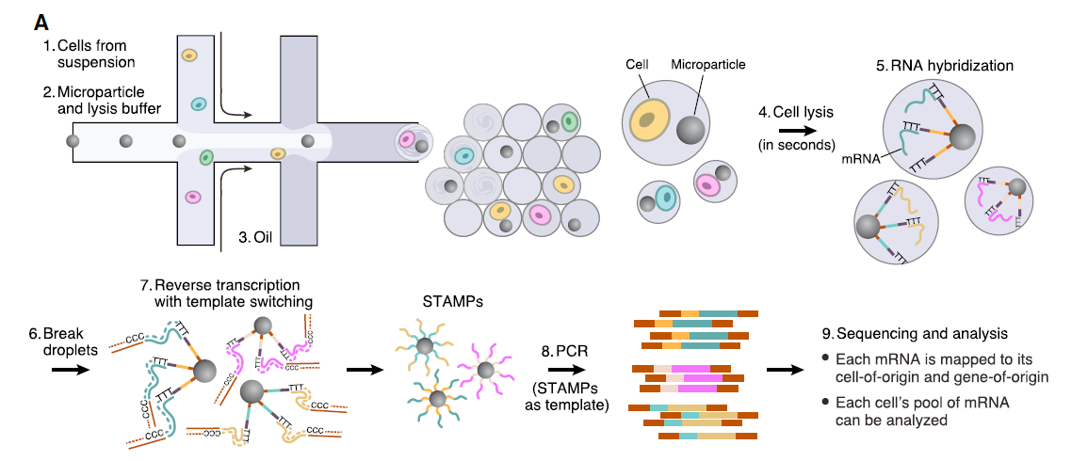
Single-cell RNA-seq
Macosko et al. Cell 2015

Slide 51
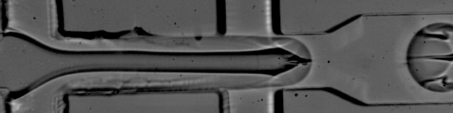
Droplet based single-cell RNA-seq
Macosko et al. Cell 2015

Slide 52

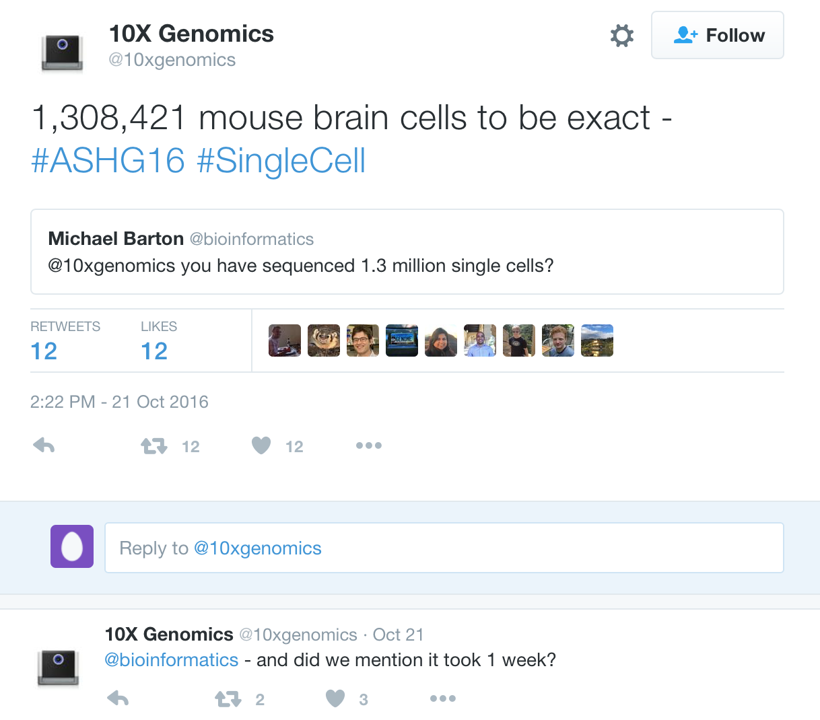
Single-cell RNA-seq data is becoming thicker
Cells/samples
Cells/samples
Genes
Genes

Slide 53
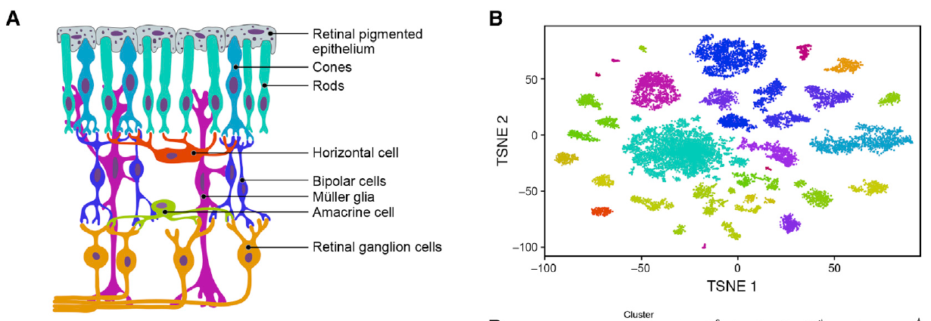
Single-cell RNA-seq allows identification of cellular subtypes
Macosko et al. Cell 2015

Slide 54
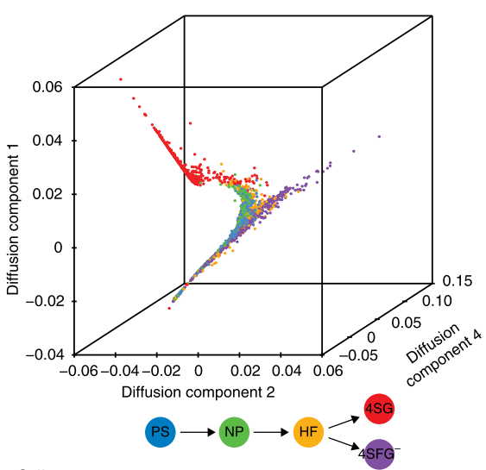
Diffusion maps identify developmental trajectories
Moignard et al, Nat Biotech 2015
Notes:
We developed a computational approach to infer cell cycle stage, and other hidden confounders, from gene expression data and´correct´gene expression values
This can improve our ability to model true underlying biological processes.
Diffusion maps, like principal component analysis, is a dimensionality reduction technique that is particulary well suited to model gradual but stochastic, diffusion like processes like differentiation.
This approach model the transition probabilities from one cell to another based on similarity in gene expression space.
Cells are more likely to transition to cells that are closer in dimension.
Using this idea one can infer the high dimensional manifold in the gene expression space.
This manifold can imply a 'pseudo' temporal ordering we call diffusion pseudotime.
What can you do with this?
We applied diffusion maps to single cell qPCR data from early blood development.
This dimension reduction approach gave us a clustering that corresponds to the early blood development progress.
Other dimension reduction techniques failed to recapitulate the biological order.
Moreover, when applying our diffusion pseudotime methodology to this data, we were able to identify the chain of TF that are turned on.
Of special importance are so called branching point genes which may only be active at branching points.
Conventional analysis focusing on the end points of differentiation stages may miss these genes.
Diff Map:
Order based on similarity in gene expression space
Decision takes place at branching points
More causal, regulatory network from transitions

Slide 55
Summary
Next generation sequencing data is big and a major part of biological research
RNA-sequencing is a popular technology to study
Gene expression
Alternative splicing
Allele-specific expression
Recommended reading:
Zhang et al. (2009) RNA-Seq: a revolutionary tool for transcriptomics. Nature.
Conesa et al. (2015) A survey of best practices for RNA-seq data analysis. Genome biology.

Slide 56
Questions?

